Slide 1
Resilience Convening
November 28th, 2017

Slide 2
Agenda
Welcome
Funder Survey Results
Funder Panel
Small Group Discussions
Next Steps

Slide 3
Funder Survey Respondents
Type of Organization | Number of Survey Respondents
Hospital Community Benefits | 3
Private/Independent Foundation | 3
Public Agency | 2
Community Foundation | 1
Corporate Foundation | 1
Other | 4
Total | 14
Notes:
ONE POINT IN TIME – Lots of uncertainty but some decisions and funding have been made and this is a snapshot.
15 orgs invited to submit survey
There was a 93 percent response rate
Survey respondents represented different types of philanthropic and non-profit organizations providing disaster-focused support in Sonoma County
11 of the 14 survey respondents are either actively making grants or developing a grant program specifically focused on disaster relief, recovery and/or rebuilding.
Three respondents indicated their organization was not planning to create a disaster-focused program or initiative but by maintaining their current funding priorities, their organization would inevitably support communities impacted by the fires

Slide 4
Allocations - 2017 and 2018
81% of survey respondents with a disaster-focused program have determined funding levels for 2017.
Over half of survey respondents with disaster-focused programs have determined funding levels for 2018.
Two survey respondents each plan to allocate over $5 million in 2018.

Slide 5
Funding Priorities
Funding Parameters | High priority (majority of survey responses)
Type of Entity | Nonprofits Individuals Public agencies
Type of Support | General operating support Nonprofit capacity building Cash to individuals Project-specific grants
Specific Populations | People who lost their homes as a result of the fires Children and youth Undocumented immigrants
Types of Services or Programs | Case management/care coordination Behavioral health services Shelter and/or temporary housing
Notes:
Diverse funders = diverse priorities

Slide 6
Information Gathering
Over 70% of survey respondents want…
Further information related to opportunities for co-funding, collaboration and/or matching resources from other funders.
Data on the immediate and/or long-term needs of specific populations/communities.
Data on the impact of the fires on the local workforce and/or economy.

Slide 7
Funder Panelists
Mike Kallhoff, CEO, United Way of the Wine Country
Susan Shaw, Co-Director, North Bay Organizing Project/UndocuFund
Matt Martin, VP of Community and Government Relations, Redwood Credit Union/North Bay Fire Relief Fund
Daniel Lurie, CEO and Founder, Tipping Point
Darius Anderson, Founder, Rebuild North Bay Foundation
Elizabeth Brown, CEO, Community Foundation Sonoma County

Slide 8
Short and Long Term Funding Priorities
Short Term
Cash assistance to those who lost their home ($1,000)
Cash assistance to those who suffered financial hardship ($250, $500, or $750)
$105,000 to support restaurants who helped fire victims
Mid Term
Supporting portable classrooms for up to two elementary schools
Long Term
To be determined
Notes:
Describe your short-term and long-term disaster-related funding priorities?

Slide 9
Process and Timeline to Allocate Funds
Individual Grants
Application online 1st week of fires
Accepting through November 30th
Upon proof of residence during fires, checks written within 2-3 weeks
Restaurant Funding
Took place within 1st two weeks of the fires
School Funding
To be determined – 1st payment expected in December
Notes:
What is the process and timeline your organization will use to allocate funds?

Slide 10
Communicate Funding Process and Results
Funding Process
Short and mid term already underway
Long term is TBD
Results
Facebook
UW newsletter
Press release
Notes:
How will you keep nonprofits informed of your grantmaking process and progress on your goals?

Slide 11
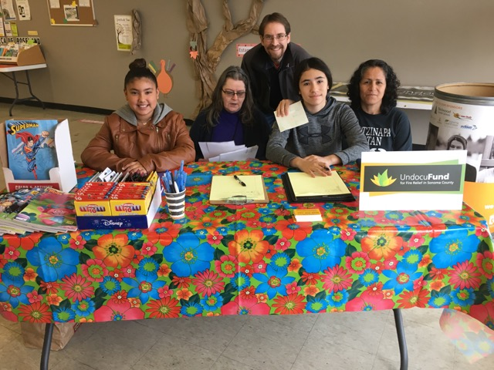
Short and Long Term Funding Priorities
To provide immediate monetary assistance for fire relief to undocumented children, individuals and families.
Assist with recovery through referral for support and services.
Raise $5 million to give meaningful level of assistance to help families recover from the fire and begin to get back on their feet.
$2,400,000 has been raised.
Notes:
Describe your short-term and long-term disaster-related funding priorities?
The UndocuFund is a collective local effort to ensure that undocumented individuals and families displaced by the fires have the support and resources they need to recover and rebuild their lives in Sonoma County, where many have put down deep roots.
To provide immediate monetary assistance for fire relief to undocumented children and families (primarily related to housing, rent and loss of wages)
Assist with recovery through aid and referral for support and services.
Our goal is to raise at least $5 million so that we can give a meaningful level of assistance to help individuals and families recover from the fires and begin to get back on their feet.
To date we have raised $2,100,000.

Slide 12
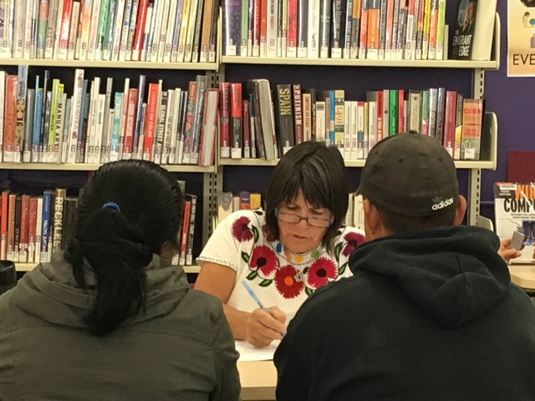
Process and Timeline to Allocate Funds
An applicant must be interviewed by an UndocuFund trained volunteer from our founding and partner organizations: CHD, Corazon Healdsburg, North Bay Organizing Project, The Graton Day Labor Center, North Bay Jobs with Justice, UniteHere2850, Jewish Free Community Clinic, SRJC, Migrant Education, Hpeace, CAP, North Bay Rapid Response Network and La Luz have all sent volunteers to accept applications.
The request is evaluated based on criteria developed by immigrant leaders and the steering committee.
Our goal is to make sure we have identified and assisted all eligible undocumented families. Beginning Jan. 1, we will start assessing and giving recovery aid.
Notes:
What is the process and timeline your organization will use to allocate funds?
An applicant must be interviewed by an UndocuFund trained volunteer from our partner organizations: CHD, Corazon Healdsburg, North Bay Organizing Project, The Graton Day Labor Center, North Bay Jobs with Justice, UniteHere2850, Jewish Free Community Clinic, SRJC, Migrant Education, HPeace, North Bay Rapid Response Network, CAP and La Luz.
The request is evaluated based on criteria developed by immigrant leaders and the steering committee.
Between now and the end of 2017 our goal to make sure we have identified and assisted all eligible undocumented families. Beginning Jan.1, to start assessing and giving recovery aid.

Slide 13
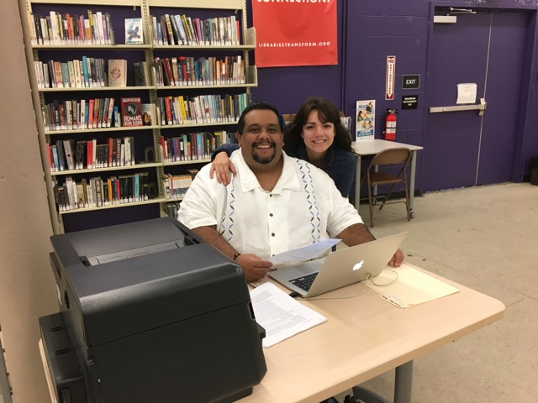
Communicate Funding Process and Results
We have given 181 families (impacting 713 people) a total of $433,500 to date.
We will post reports on our website and give this information directly to our partners.
Thank you all for your investment and support!
Notes:
How will you keep nonprofits informed of your grantmaking process and progress on your goals?
We have given xxx families an average grant of $2,300 for a total of XXX in aid. (can I get this in on 11/26)
We will post reports on our website and give this information directly to our partners.

Slide 14
Funding Priorities Immediate Relief
North Bay Fire Relief Fund
Disaster relief
100% to victims through individual grants &/or services
Four impacted counties
Grantmaking
Individual grants
Organizational grants
Fire victims
Loss of home
Economic hardship
Businesses
Loss of facilities
Disruption of business
Community well-being
Holiday support
Athletic leagues
Nonprofits
Individual grants
Supportive services
Basic needs
Health and community wellbeing specific to fire victims
Transportation
Continuity of social services impacted by fire
Emergency financial assistance
Bridge to recovery strategies
Notes:
Describe your short-term and long-term disaster-related funding priorities?

Slide 15
Process and Timeline to Allocate Funds
North Bay Fire Relief Fund
Initial grantmaking commenced on October 16th
Redwood Credit Union Community Fund Board
Advisory committee
Nonprofit application process
Grants committee
Online process (www.rcucommunityfund.org/nbfrf-grant-app/)
Open 11/20; Close 12/11
Priorities
Basic needs
Health and community wellbeing specific to fire victims
Transportation
Continuity of social services impacted by fire
Emergency financial assistance
Grants range up to $300,000
Gathered data to help inform recovery strategy
General operating support
NBFRF ramp-down target, May 31 2018
Coordination with recovery disaster strategies
Notes:
What is the process and timeline your organization will use to allocate funds?
Basic needs
Food security/distribution
Housing preservation/home repair
Shelter, temporary housing needs
Health and community wellbeing specific to fire victims
Behavioral health services
Medical care
Transportation
Continuity of social services impacted by fire
Case management/care coordination
Childcare
Elder care
Emergency financial assistance
Economic hardship
Loss of home

Slide 16
Communicate Funding Process and Results
North Bay Fire Relief Fund
Total funds raised through 11/18: $21,596,825
Total funds distributed/committed through 11/18: $13,617,041
$200,000 to First responders: Funds have been provided to 93 first responders
$525,000 to support:
Urgent food needs of fire victims: Redwood Empire Food Bank (serving Sonoma, Mendocino & Lake Counties) and Community Action Napa Valley (CANV).
Immediate/short and midterm housing for fire victims: Petaluma People Services and Catholic Charities of Santa Rosa.
Over $1.05 million to support students who lost homes:
$932,000 for K-12 Students: $500 gift cards have been/are being provided to students who lost homes in the four affected counties for school clothes and supplies.
$120,250 for College Students: Funds have been provided to support college students who lost homes in the four affected counties.
$7 million to support people who lost homes: We’ve partnered with several nonprofits in the four impacted counties to help distribute individual grants.
SONOMA COUNTY: United Way of the Wine Country and La Luz Center
NAPA COUNTY: Center for Volunteer and Nonprofit Leadership (CVNL)
MENDOCINO & LAKE COUNTIES: North Coast Opportunities
Notes:
How will you keep nonprofits informed of your grantmaking process and progress on your goals?

Slide 17
Communicate Funding Process and Results
North Bay Fire Relief Fund
$3.28 million to support people experiencing economic hardship
United Way of the Wine Country
Center for Volunteer & Nonprofit Leadership
Community Action Partnership
La Luz Center
UndocuFund
North Coast Opportunities
California Human Development
$1 million to support small businesses to support the re-establishment of business operations, including store front, agricultural and home businesses.
LARCA (Lake Area Rotary Club)
$374,791 to support Community Well-Being
Holidays for Fire Victims: For families and individuals who lost their homes in the fires.
Rincon Valley Little League: Funds to replace equipment burned in the fires—impacting 840 kids.

Slide 18
Short and Long Term Funding Priorities
Focus on low-income, vulnerable populations
Phase 1: Relief (3 months), deliver funds quickly through trusted North Bay partners
Phase 2: Recovery (3-9 months), conduct due diligence to evaluate needs and determine additional grants
Phase 3: Rebuild (4-12 months), address additional longer-term needs
Notes:
Describe your short-term and long-term disaster-related funding priorities?

Slide 19
Process and Timeline to Allocate Funds
Organizations vetted and recommended on a rolling basis as needs emerge and due diligence is conducted
Currently staffed through existing team, but intend to hire dedicated program officer to lead grantmaking
Oversight provided by Tipping Point Emergency Relief Fund board committee
All funds allocated by December 2018
Notes:
What is the process and timeline your organization will use to allocate funds?

Slide 20
Communicate Funding Process and Results
October 2017: Announce fund, process, campaign
November 2017: Announce initial fundraising total, investment distribution to date ($2M) + allocation
December 2017 – December 2018: Ongoing investment distribution + allocation updates to partners, donors + general public (website)
November 2018: Summary of efforts one year later
February 2019: Report out after final funds are distributed
Notes:
How will you keep nonprofits informed of your grantmaking process and progress on your goals?

Slide 21
About Rebuild North Bay Foundation
Notes:
What is the process and timeline your organization will use to allocate funds?

Slide 22
Short and Long Term Priorities
Short Term Goals:
Our goal is to identify and support victims who have the least amount of resources
Coordination: Building an organized coalition of non-profits & government agencies to encourage alignment of funding, programmatic and volunteer resources for rebuilding
Advocacy: Advocating on behalf of impacted communities to FEMA, OEA and other disaster assistance funds
Travel to Washington D.C. to lobby key legislators | January 2018
Housing: Coordinating with organizations supporting families needing short-term support.
Long Term Goals:
Our goal is to assist community leaders in the long-term effort of post fire recovery and the building of a better and safer future.
Engage National & International resources to ensure the region receives ample funding from State and Federal agencies.
James Lee Witt
Housing
Open Space & Working Lands
Stabilization and Economic Recovery
Education
Advocacy
Notes:
Describe your short-term and long-term disaster-related funding priorities?

Slide 23
Outreach
Rebuild Northbay Foundation: Communications and Marketing Committee
Promote funding opportunities
Ensure transparency in the community
Annual Report
Social Media
Partner with the Press Democrat
Notes:
How will you keep nonprofits informed of your grantmaking process and progress on your goals?

Slide 24
Short and Long Term Funding Priorities
Sonoma County Resilience Fund: $8.5M for mid to long term recovery and rebuild
Short Term: Initial round of Emergency Grants to support organizations providing immediate relief such as shelter, food, and other basic needs
Long Term: Over the next several months we will develop a grantmaking strategy focused on recovery and rebuilding.
First steps: Listen, Learn, Leverage
Funds will support organizations working with people impacted by the fires in a variety of ways—loss of home, business, job, renters, etc.
Equity will be at the center of our grantmaking—we know some will need more to have the same.
Notes:
Describe your short-term and long-term disaster-related funding priorities?

Slide 25
Process and Timeline to Allocate Funds
Process: We will develop our grantmaking strategy from what we learn from you and from the field through:
Data collection and analysis
Convening(s) with nonprofits and community leaders
Engaging Disaster Experts: Northern California Grantmakers, Center for Disaster Philanthropy, and Community Foundations across the country who have gone through disasters themselves
Coordinating with Fire Recovery Funders
Timeline: We intend to start making grants within six months and will likely continue for many years.
Notes:
What is the process and timeline your organization will use to allocate funds?

Slide 26
Communicate Funding Process and Results
We will share our progress and results through:
Our newsletters
Website (www.sonomacf.org)
Social media
In-person convenings
Contact us: Elizabeth Brown, Karin Demarest, Elly Grogan
Notes:
How will you keep nonprofits informed of your grantmaking process and progress on your goals?

Slide 27
Questions?

Slide 28
Small Group Discussions
Please take notes of your discussion on the paper provided at your table. Thank you!
What is the core value or key guiding principle that guides your organization’s relief, recovery and/or rebuilding work?
What community/communities does your organization serve and what are the greatest needs related to fire recovery?
Despite the loss, what opportunities has the disaster created?

Slide 29
Thank you! We are grateful for the work you do to support our community.

